Slide 1
Release 1 – GuMaJoKl Curreny Exchange
Günther miklas
Mathias Siimon
Joosep Rehepapp
Klaus Jesper Zaletajev

Slide 2
Problem Statement and Project Scope
Purpose:
The main purpose of this system is to provide currency conversion transactions within a 2-second timeframe, generate receipts and maintain operation records for further analysis
Scope:
Included functionality: transaction data input, automated exchange calculations, transaction creation
Excluded functionality: internet banking, tax services,
Benefits: reduced human error, faster service, easier management of funds
Key features: automized calculations, retrievable receipts, file storage

Slide 3
User Stories
As a client, I want to exchange a specific currency at a given rate, so I receive the target amount.
As a client, I want to receive a receipt of the transaction, so I have proof of the transaction.
As a cashier, I want to generate the end-of-day report, so managers can see transactions that happened.
As a cashier, I want to check the currency amount in the reserve before a transaction, so I can ensure that the transaction can happen
As a manager, I want to change the exchange rate of a specific currency, so I control revenue.

Slide 4
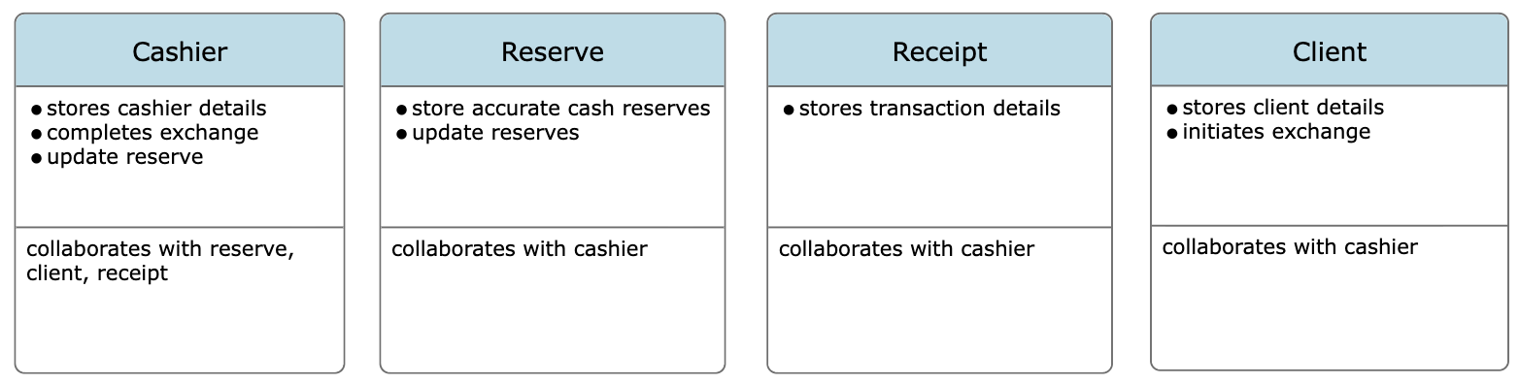
CRC Cards

Slide 5
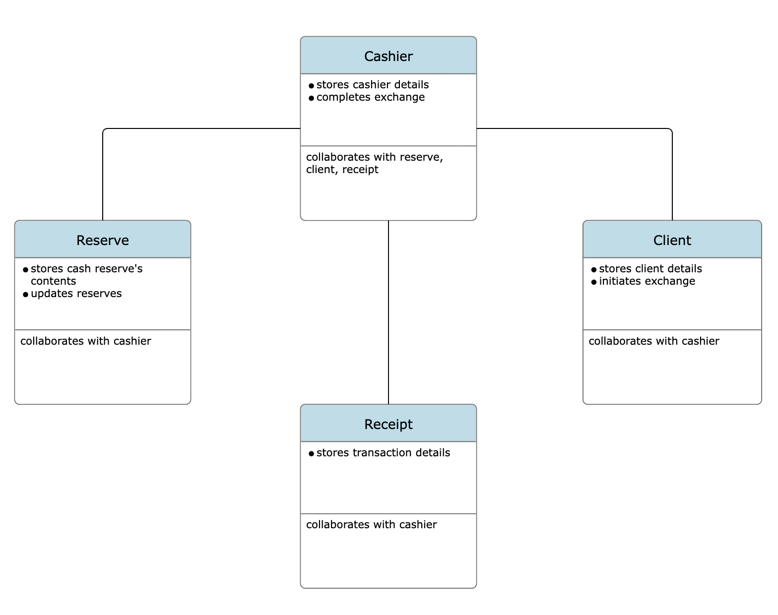
Conceptual Diagram

Slide 6
Traceability Table
User Story | CRC Responsibility | Class Diagram Element | C++ Element
Client exchanges currency | Cashier: completes exchange | Cashier - Transaction | Cashier::exchange(const Transaction& tx)
Print a receipt | Cashier: print a receipt | Cashier - Transaction | Cashier::printReceipt(const Transaction& tx)

Slide 7
Team Roles
Mathias Siimon:
Emotional support
(Buddy is at a military exercise)
Klaus Jesper Zaletajev:
SRS Documentation
Joosep Rehepapp:
CRC cards
Conceptual diagram
Günther:
Initial Github repository setup
Defining workflow
Conceptual code inside main.cpp
The Slides

Slide 8
Lessons Learned
Do things as we go, not on the last day
Had some difficulties understanding the CRC cards concept and the diagramm
Gained a better overview of the necessity of the SRS documentation
Learned some C++
Difficult to visualize the project flow, code design and functionality implementation

